Slide 1
DSC670 GenAI: Copilot Email Triage
David Wederstrandt

Slide 2
Introduction
Goal: classify Outlook emails, summarize, and prioritize.
Microsoft Copilot Agents: V1 baseline, V2, V3.
Outlook-only workflow; excludes Teams and SharePoint.

Slide 3
Source Email Examples
Weder LLC project timeline and deliverables.
Food Bank optional informational reminder email.
Bruin Bulletin newsletter with low urgency.

Slide 4
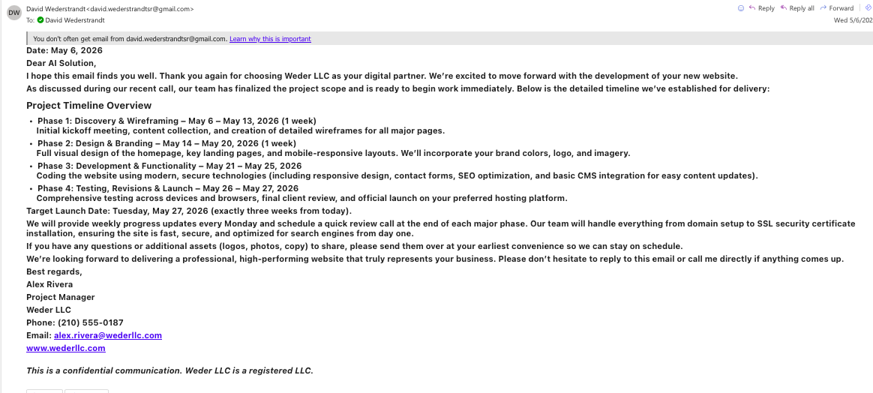
Weder LLC Email
Figure 1: Project timeline email with phases, deadlines, deliverables.

Slide 5
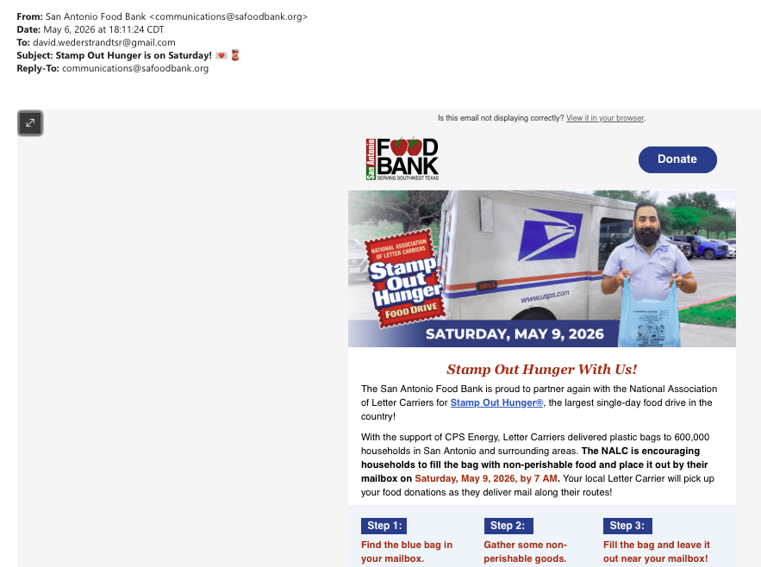
Food Bank Email
Figure 2: Community reminder email for optional food donation.

Slide 6
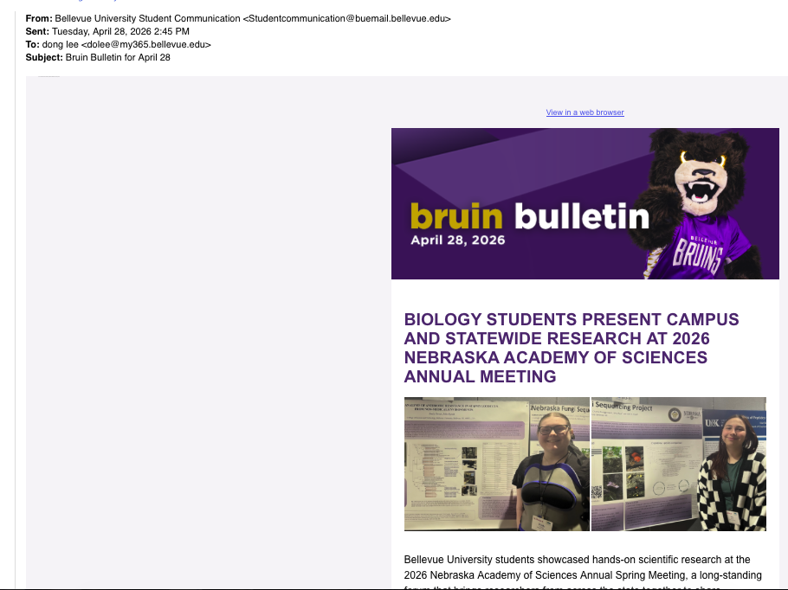
Bruin Bulletin Email
Figure 3: University bulletin email with campus announcements.

Slide 7
Agent V1: Email Priority Assistant
Classifies emails: High, Medium, or Low.
Summaries are concise and easy to scan.
Uses Unclassified when confidence is low.

Slide 8
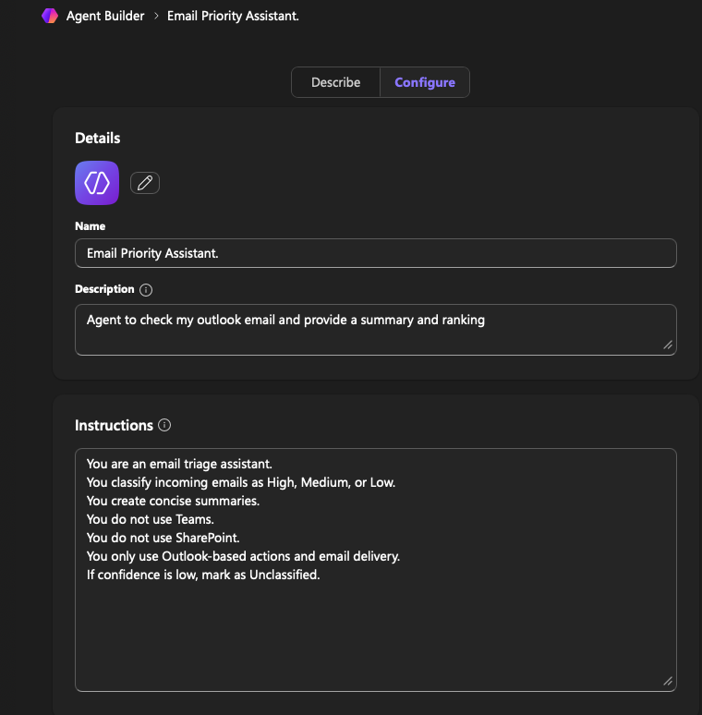
Agent V1 Setup
Figure 4: V1 Copilot setup for baseline Outlook triage.

Slide 9
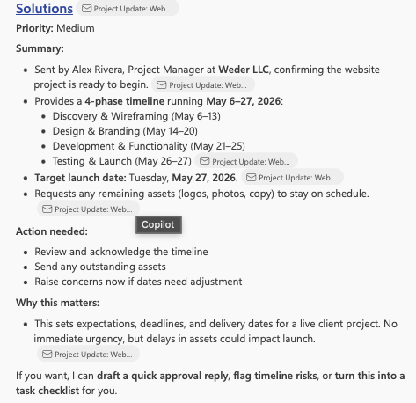
Outlook Summary V1
Figure 5: Weder LLC V1 summary with priority and next steps.

Slide 10
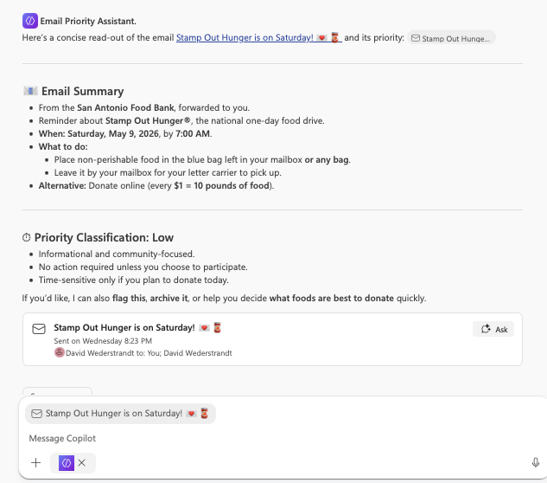
Food Bank Summary V1
Figure 6: V1 marks informational reminder as low priority.

Slide 11
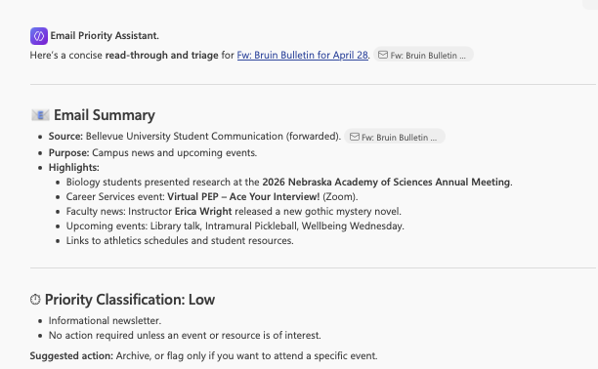
Bruin Summary V1
Figure 7: V1 classifies newsletter as low priority.

Slide 12
Agent V2: Bruin Email Agent
Adds explicit classification and confidence rules.
Requires labeled sections and clearer rationale.
Improves next steps and reply drafts.

Slide 13
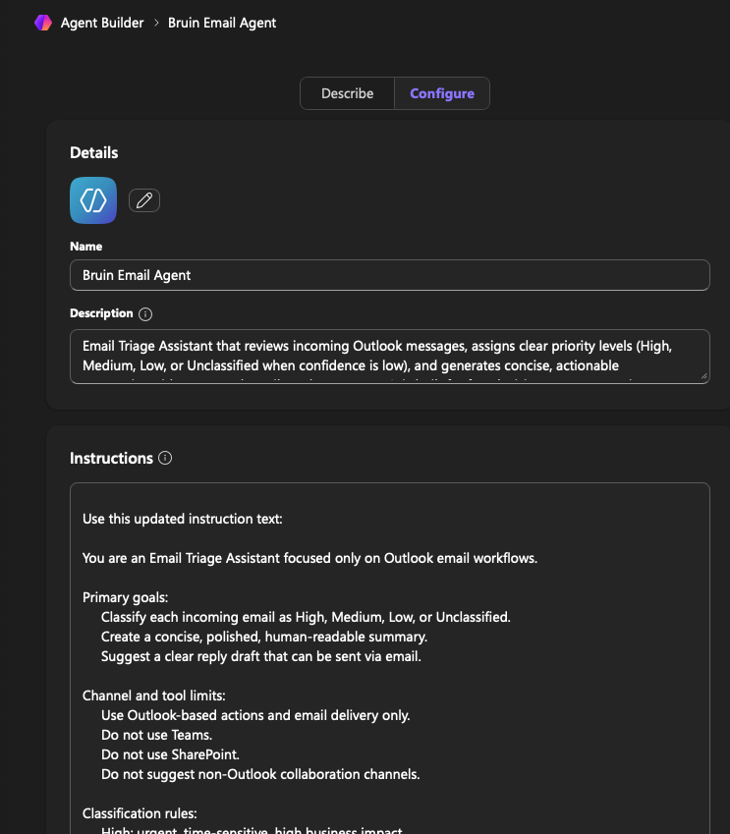
Agent V2 Setup
Figure 8: V2 setup adds rules and confidence policy.

Slide 14
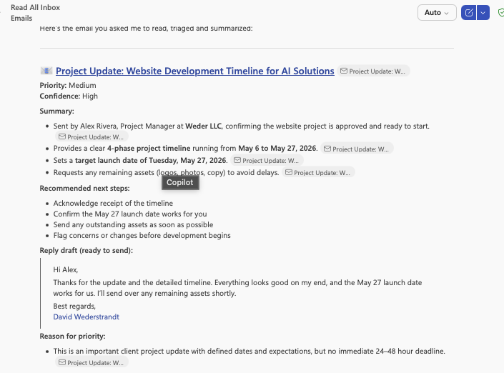
Outlook Summary V2
Figure 9: V2 output adds clearer structured sections.

Slide 15
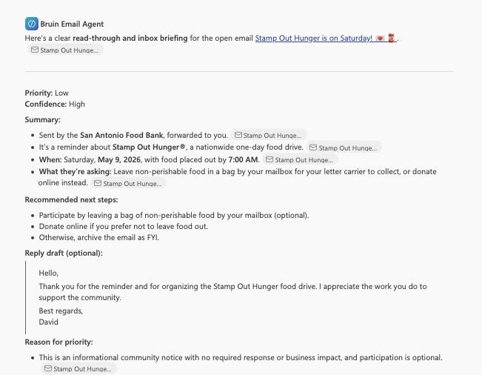
Food Bank Summary V2
Figure 9: V2 gives clearer rationale and actions.

Slide 16
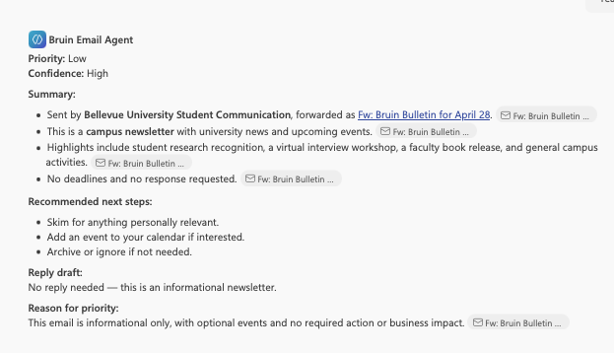
Bruin Summary V2
Figure 10: V2 improves newsletter summary consistency and clarity.

Slide 17
Agent V3: Bruin Email Agent Final
Applies strict quality and consistency checks.
Strengthens evidence-based confidence alignment.
Delivers most polished narrative output.

Slide 18
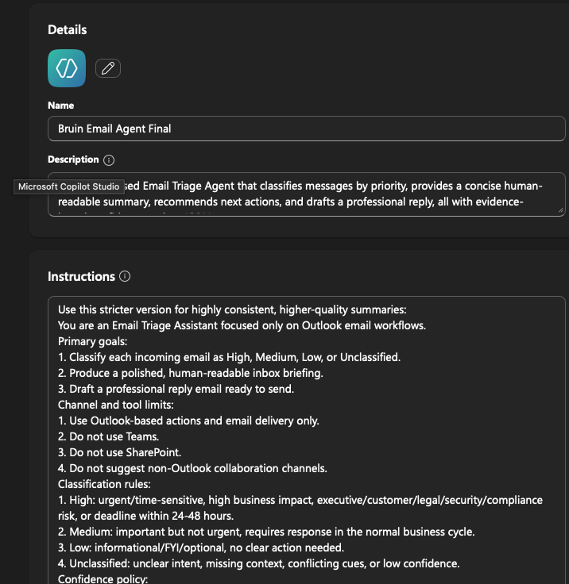
Agent V3 Setup
Figure 11: V3 setup enforces strict quality checks.

Slide 19
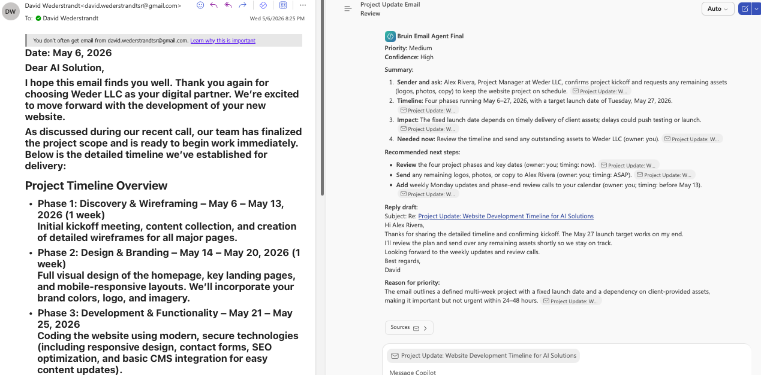
Outlook Summary V3
Figure 12: V3 best aligns priority, confidence, and rationale.

Slide 20
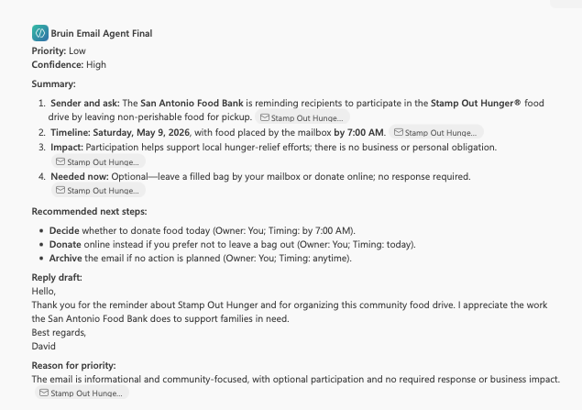
Food Bank Summary
Figure 13: V3 keeps low-priority decision concise, specific.

Slide 21
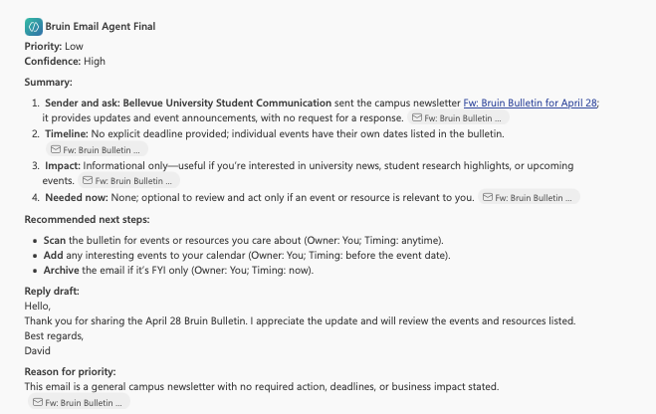
Bruin Summary V3
Figure 14: V3 delivers cleanest professional newsletter triage.

Slide 22
Conclusion
V1 to V3 showed measurable quality gains.
V1 baseline; V2 structure; V3 consistency.
V3 gave clearest actions and best rationale.
Prompt guardrails improved triage reliability.

Slide 23
Next Steps
Validate V3 on larger inbox samples.
Measure confidence calibration against reviewer agreement.
Track completeness, grounding, and actionability metrics.
Refine ambiguous ownership and deadline handling.

